Slide 1
Practice Session 7
An Inconvenient Truth

Slide 2
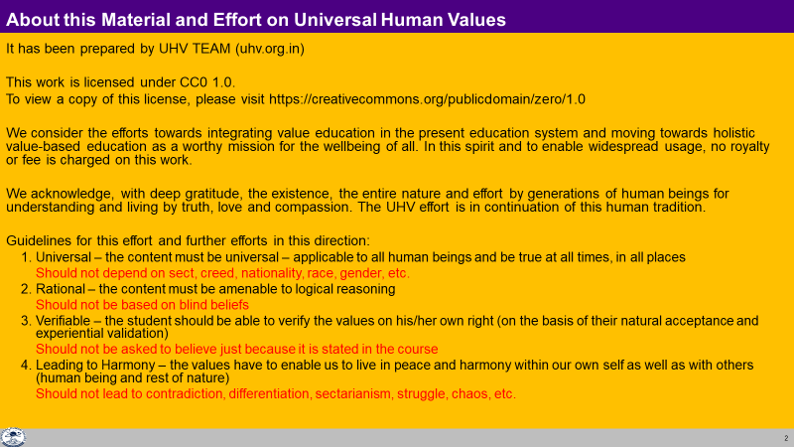

Slide 3
An Inconvenient Truth
Watch the video An Inconvenient Truth
It is a 2006 documentary about global climate change presented by Former US Vice President Al Gore. He raises the question
“What were you doing when you had the time to do something?”
Source: http://an-inconvenient-truth.com/
Observe:
  State of the Planet
  Root Cause of the Problems
  Solution for the Problems
We will discuss your observations

Slide 4
Discussion
Root Cause of the Problem (as stated in the video)
Population
New Technology + Old Habits
Our Way of Thinking
Assumption: The Earth is so big that humans can not have any lasting impact on it
What gets us into trouble is not what we don’t know… It’s what we know for sure that just ain’t so
With incorrect assumptions, the recognition & fulfilment is also incorrect, i.e. it is not mutually enriching with Nature nor mutually fulfilling for Human Being

Slide 5
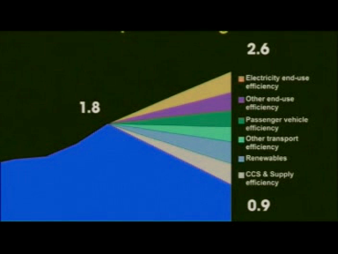
Suggestions about Solution (Technology)

Slide 6
Current Approach Work to be Done in Society
Problem – Population, old habits,
Our way of thinking
(or only symptom?)
Action taken to get rid of it – Technology
(or symptomatic relief – Temporary?)
Clarity of All Encompassing Solution (Samadhan)
2. Effort for All Encompassing Solution
Human Education,
Human Conduct,
Human Constitution,
Human Order
3. Problem – Analysis in the light of Samadhan – Inhuman Conduct (exploitation of nature, domination… are only the symptoms)
4. Effort for getting rid of problem – Ensure Human Conduct through Human Education

Slide 7
Problem (restated)
Population → Population without Right Understanding
New Technology + Old Habits → Technology developed and used without Right Understanding i.e. with wrong assumptions
Our Way of Thinking → Thinking on the basis of wrong assumptions (preconditioning, sensation)

Slide 8
Based on Understanding Nature, Human Being can Decide its Role vis-à-vis each Order
ORDERS 4 voLFkk | UNITS bdkbZ | ACTIVITY fØz;k | NATURAL CHARACTERISTIC LoHkko] O;oLFkk esa Hkkxhnkjh (Participation in larger order) | INNATENESS /kkj.kk] /keZ Lo;a esa O;oLFkk (Self-organisation) | INHERITANCE vuq’kaxh;rk
Physical inkFkZ | Soil, Metal feV~Vh] /kkrq | Formation-Deformation jpuk&fojpuk | Composition-Decomposition LakxBu&fo?kVu | Existence vfLrRo | Constitution based Ikfj.kke vuq’kaxh
Pranic izk.k | Plants, Trees isM+] ikS/ks | "-“ + Respiration “olu&iz”olu | " + Nurture-Worsen lkjd&ekjd | " + Growth iqf’V | Seed based cht vuq’kaxh
Animal tho | Animals, Birds i”kq] i{kh | "-“, " in Body “kjhj esa Selecting-Tasting in I p;u@vkLoknu eSa esa | ", " in body “kjhj esa Cruelty, Non-cruelty in I eSa esa Øwjrk] vØwjrk | ", " in Body “kjhj esa Will to live in I eSa esa Tkhus dh vk”kk | Breed based oa”k vuq’kaxh
Human Kku | Human Beings euq’; | "-“, " in Body “kjhj esa Imaging, Analysing-Comparing, Selecting-Tasting in I fp=.k] fo'ys’k.k] p;u@vkLoknu eSa esa Natural Acceptance, Potential for Understanding… in I le>us dh {kerk eSa esa | ", " in body “kjhj esa Potential for Perseverance, Bravery, Generosity… in I eSa esa /khjrk] ohjrk] mnkjrk | ", " in Body “kjhj esa Will to live with continuous happiness in I eSa esa fujarj Lkq[kiwoZd Tkhus dh vk”kk Right Feeling & Thought lek/kku Right Understanding Kku | Education-Sanskar based f”k{kk&laLdkj vuq’kaxh

Slide 9
Are We Playing our Role in Nature?
To understand the inherent harmony in nature and to live accordingly, i.e.
  To facilitate a conducive environment for the activity (at least not violate it) of all orders
  To facilitate the innateness (or at least not violate it) of all orders
  To facilitate the inheritance (or at least not violate it) of all orders
Order | Human Participation for Mutual Fulfillment
Physical Order | Facilitate its existence by ensuring conducive environment and maintaining / ensuring its constitution (eg. constitution of earth)
Bio Order | Facilitate its growth by ensuring conducive environment and maintaining / ensuring its seed (e.g. seed of rice)
Animal Order | Facilitate care of the body by ensuring physical facility, environment for existence & growth of body. To ensure its will to live Maintaining / ensuring its breed (eg. breed of cow)
Human Order | Facilitate care of the body by ensuring physical facility, environment for existence & growth of body Facilitate its will to live with continuous happiness by ensuring human education-sanskar, participating in developing / maintaining undivided society & universal human order

Slide 10
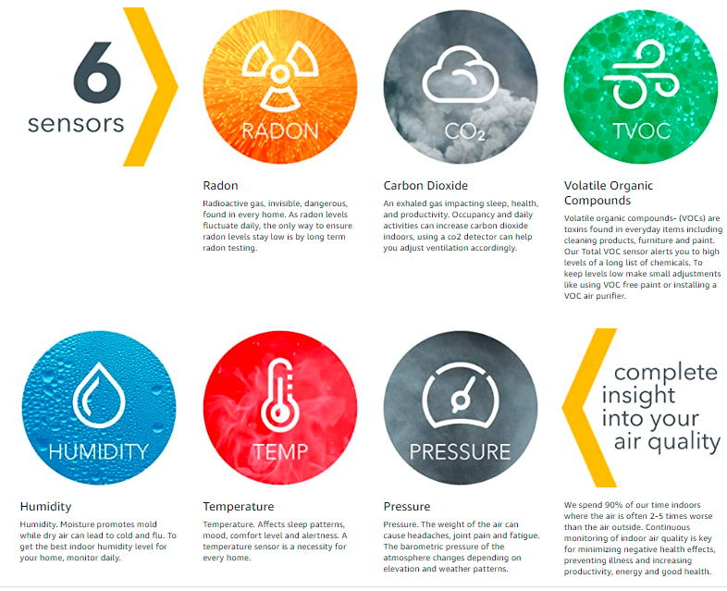
Air Quality

Slide 11
Water Quality
They include dissolved oxygen, pH, temperature, salinity and nutrients (nitrogen and phosphorus). They also include measures of toxicants such as insecticides, herbicides and metals.

Slide 12
Soil Quality
Carbon Content at least > 1. Trai regions have ~60
Presence of earthworms…
Silt
ORGANIC MATTER
Soil organic matter represents the organic constituents of the soil. Most of it are plant and animal residues. It contributes to the soil structure, the soil fertility and the water holding capacity of the soil. Soils rich in organic matter (4-5%) will be more fertile.
The organic matter can contribute nitrogen, phosphorus and sulfur to the crop.
SAR
Stands for Sodium Absorption Ratio
Soils with SAR greater than 10 are considered to be sodic. Sodic soils have structural problems, which result in poor water infiltration. The soil tends to swell when wet and crack when dry.
Soil pH is one of the most important parameters on your soil test report. The ideal soil pH range for most crops is between 5.8 and 6.5, a range in which most nutrients are available for the crops to take them in.
EC
Stands for Electrical Conductivity. It is a measure of the salinity of the soil.

Slide 13
Food Quality

Slide 14
Ecosystem Health Indicators
Source: https://environment.des.qld.gov.au/management/water/health-indicators

